Slide 1
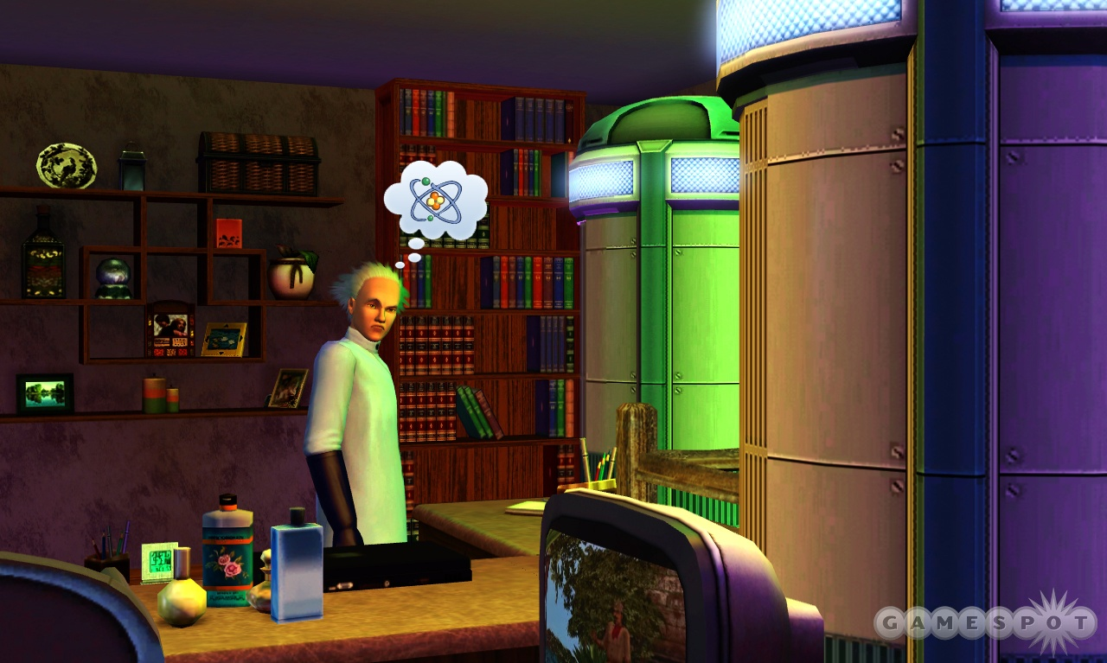
CRAZY SCIENTIST

Slide 2

To enable the students to work as a team and building team spirit.
To enable the students to develop their imaginary and critical thinking skills
To enable students to think about the pros and cons of any product
To help students to remove stage fear
To promote original thinking

Slide 3

Students will be divided into groups of four or five. They have to think of a product that is a combination of an invention and imagination. They have to prepare a presentation in a group and talk about the product they have invented.

Slide 4

You have to speak up about the utility of the product, material that the product is made of, people benefited from the product, pros and cons of the products etc. All participants have to equally participate in the presentation. Students have to speak about the pros and cons of the product during the presentation.

Slide 5


Slide 6


